Slide 1

IOT Based Home Automation
Session Jan to June 2017
Synopsis Report
For the Degree of
Bachelor Of Computer Application (BCA)
Submitted To:
Project Guide Submitted By
Guide Name: Mr Anand Pandey Students Name: ShahRukh Khan, Milan Sikarwar Designation: Asst. Professor Roll No.: BCAN1CA14040/54

Slide 2
INDEX
Abstract
Objective
Components Required
3.1 Arduino
3.2 Relay Board
3.3 HC-05 Bluetooth Module
3.4 Android Application
3.5 Android Phone
3.6 A bulb and wires for illustration purposes
Proposed Model
Conclusion
References

Slide 3
ABSTRACT
With the advancement of Automation technology, life is getting simpler and easier in all aspects. In today’s world Automatic systems are being preferred over manual system.
Modern houses are gradually shifting from conventional switches to centralized control system, involving wireless controlled switches.
Wireless Home Automation system(WHAS) is a system that uses computers or mobile devices to control basic home functions and features automatically through internet or local connection. An automated home is sometimes called a smart house.
A simple Device (phone or a Computer) can be used to control the home appliances whether it will be a Television, Refrigerator or any other appliance.

Slide 4
OBJECTIVE
In this project a simple android phone and Arduino (programmable microcontroller board) will be used to control the home appliances whether it will be a Television, Refrigerator or any other appliance.
And Bluetooth will be used to provide connection between microcontroller and mobile phone.
Here, we will show the controlling of the single appliance with an Android phone, but any number of the appliances can be controlled depending on the number of channel of relay board.
Appliance can be controlled with a single click or with the voice of the person.

Slide 5
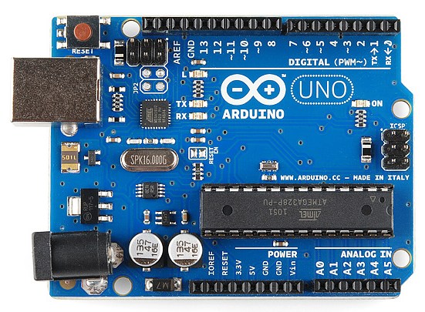
COMPONENTS REQUIRED
Arduino
Arduino is an open-source programmable microcontroller board. The programming Language used to program the microcontroller board is C and C++.
It can be loaded with program code from a computer with the USB connection .

Slide 6
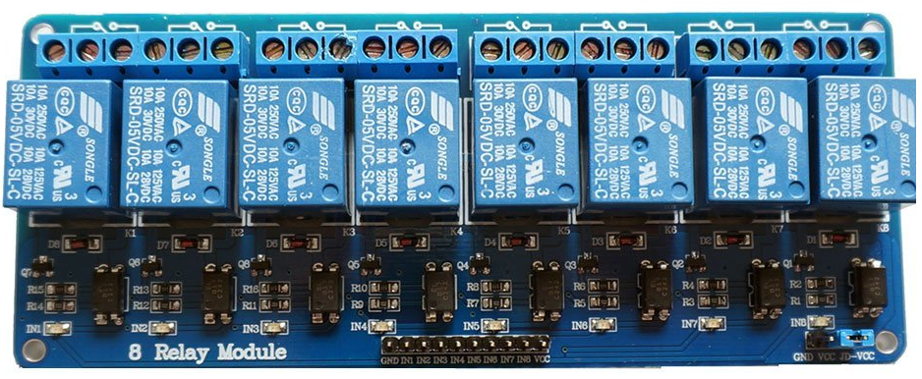
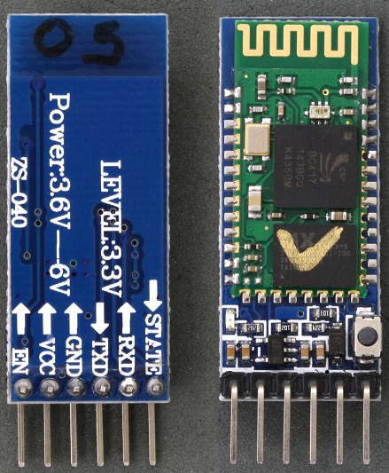
2. Relay Board
The Single Relay Board can be used to turn lights, fans and other devices on/off while keeping them isolated from your microcontroller.
3. HC-05 Bluetooth Module
Bluetooth is a wireless technology standard for exchanging data over Bluetooth connectivity.

Slide 7
4. Android Application
“RoboRemo” - for Controlling with clicks.
“BT Voice Control for Arduino” – For controlling with voice
5. Android Phone
Android Phone will be used to control the appliance remotely with the help of Bluetooth connectivity.
6. A bulb and wires for illustration purposes.

Slide 8
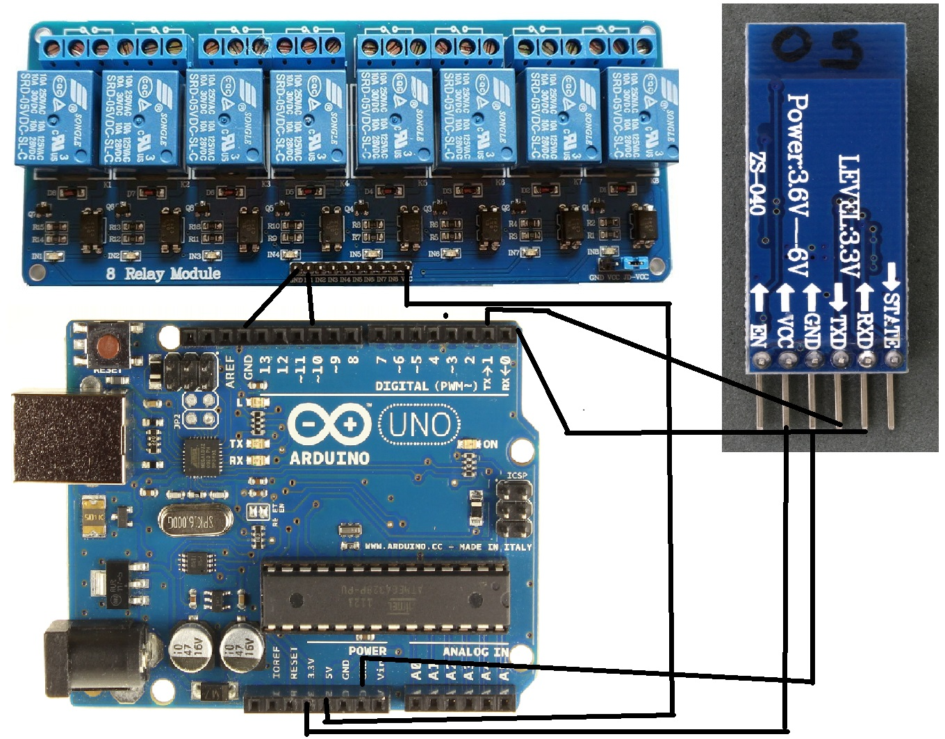
Proposed Model

Slide 9
Conclusion
The home automation using Internet of Things has been experimentally proven to work by connecting simple appliances to it and the appliances were successfully controlled remotely. The programmed controller processes according to the requirement, for example switching on the light when the on button is clicked on the phone. This will help the user to control the appliances without going near to the appliance.

Slide 10
Future Scope
Using this system as framework, the system can be expanded to include various other options which could include home security feature like capturing the photo of a person moving around the house and storing it onto the cloud. This will reduce the data storage than using the CCTV camera which will record all the time and stores it. The system can be expanded for energy monitoring, or weather stations.

Slide 11
References
[1]. Arduino IDE : https://www.arduino.cc/en/main/software
[2]. BT Voice Control for Arduino : https://play.google.com/store/apps/details?id=robotspace.simplelabs.amr_voice&hl=en
[3]. RoboRemoFree - Arduino control : https://play.google.com/store/apps/details?id=com.hardcodedjoy.roboremofree&hl=en
[4]. Relay Board : https://en.wikipedia.org/wiki/Relay
[5]. Bluetooth Module HC-05 : https://wiki.eprolabs.com/index.php?title=Bluetooth_Module_HC-05

